Slide 1
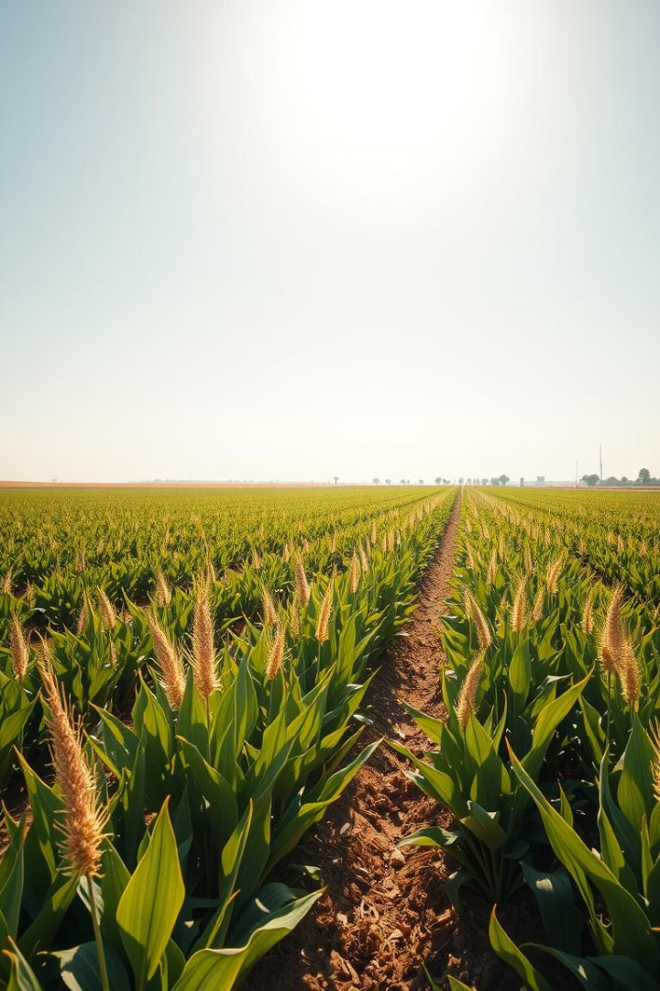

Mini Project
AgriHorti Vision
Empowering Farmers with AI-Powered Crop Disease Detection
Team Members: i. Hiyansh Sharma
ii. Mukul Sharma
iii. Anmol Tyagi
Couse : BTech CSE AI/ML Section B
Under Supervision of : Mr. Vishwanil Suman

Slide 2
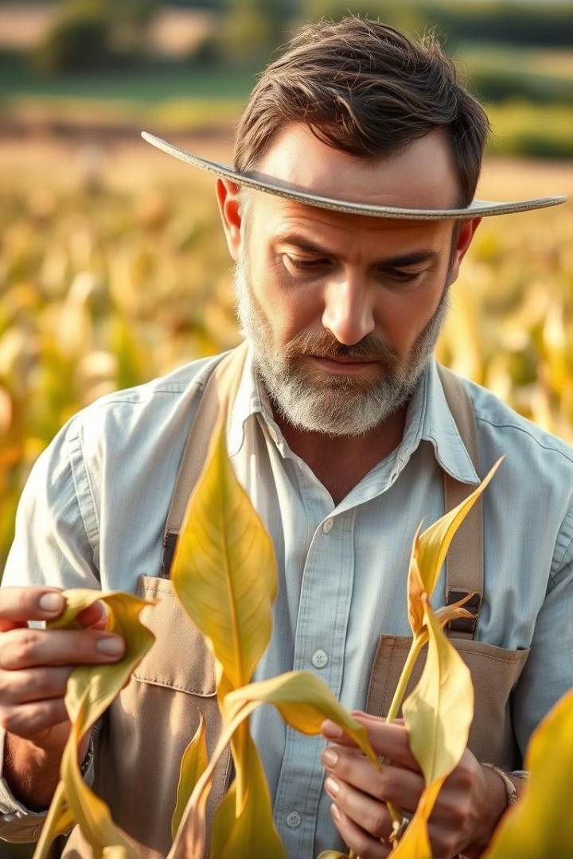

Problem Statement
Farmers struggle to detect crop diseases early.
Limited access to expert diagnosis increases risks.
Delayed detection leads to lower yields and losses.

Slide 3
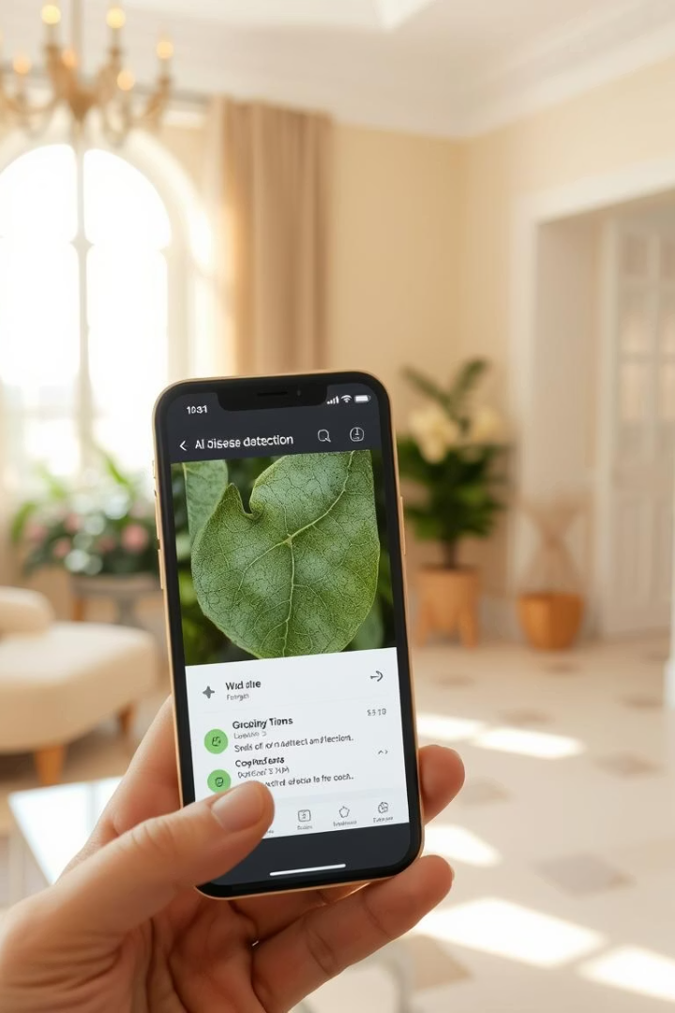
Our Solution
Image-based AI Detection
Treatment Suggestions
Analyze crop images to identify diseases instantly.
Provide actionable remedies to manage crop health.
Report Storage
Save diagnosis history for easy future reference.

Slide 4





Tech Stack
Frontend
Backend & ML
Storage & APIs
HTML
TensorFlow.js
Browser Local Storage
CSS
Pre-trained Image Classification Model
HTML5 MediaDevices API for Camera
JavaScript
This Photo by Unknown Author is licensed under CC BY-SA

Slide 5
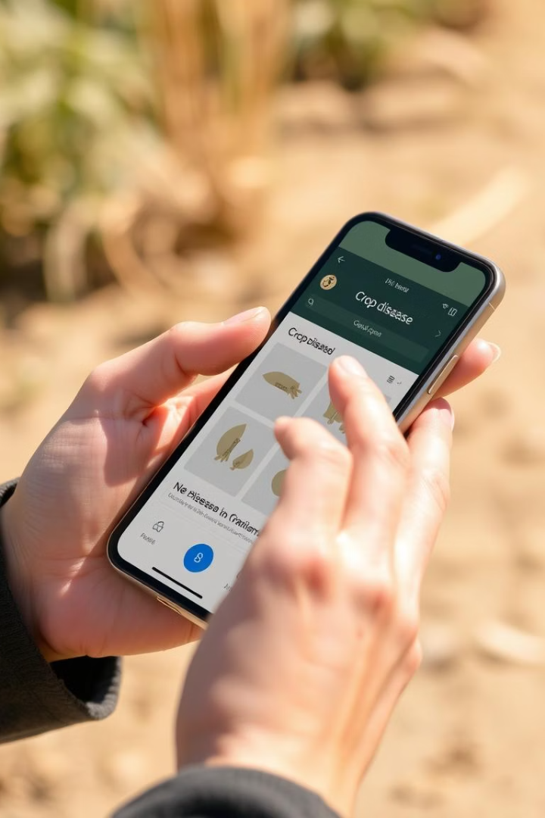




Features
Image Upload
Disease Detection
Treatment Guidance
Use existing photos or capture live images.
ML model identifies disease symptoms precisely.
Detailed symptoms, remedies, and precautions.
Analysis History
Track past reports for ongoing crop health checks.

Slide 6
AgriHorti Vision : Site Visit
AgriHorti Vision - Home

Slide 7
Future Expansion
Real-time Detection
1
Use mobile camera streams for instant diagnosis.
2
Voice Assistant
Support illiterate farmers via speech-enabled help.
Soil & Weather Data
3
Offer tailored crop suggestions based on conditions.
4
Multilingual Support
Include regional languages for wider accessibility.
Expert Chat
5
Integrate live expert advice for complex issues.
6
Growth Tracking
Dashboard with crop progress and notifications.

Slide 8
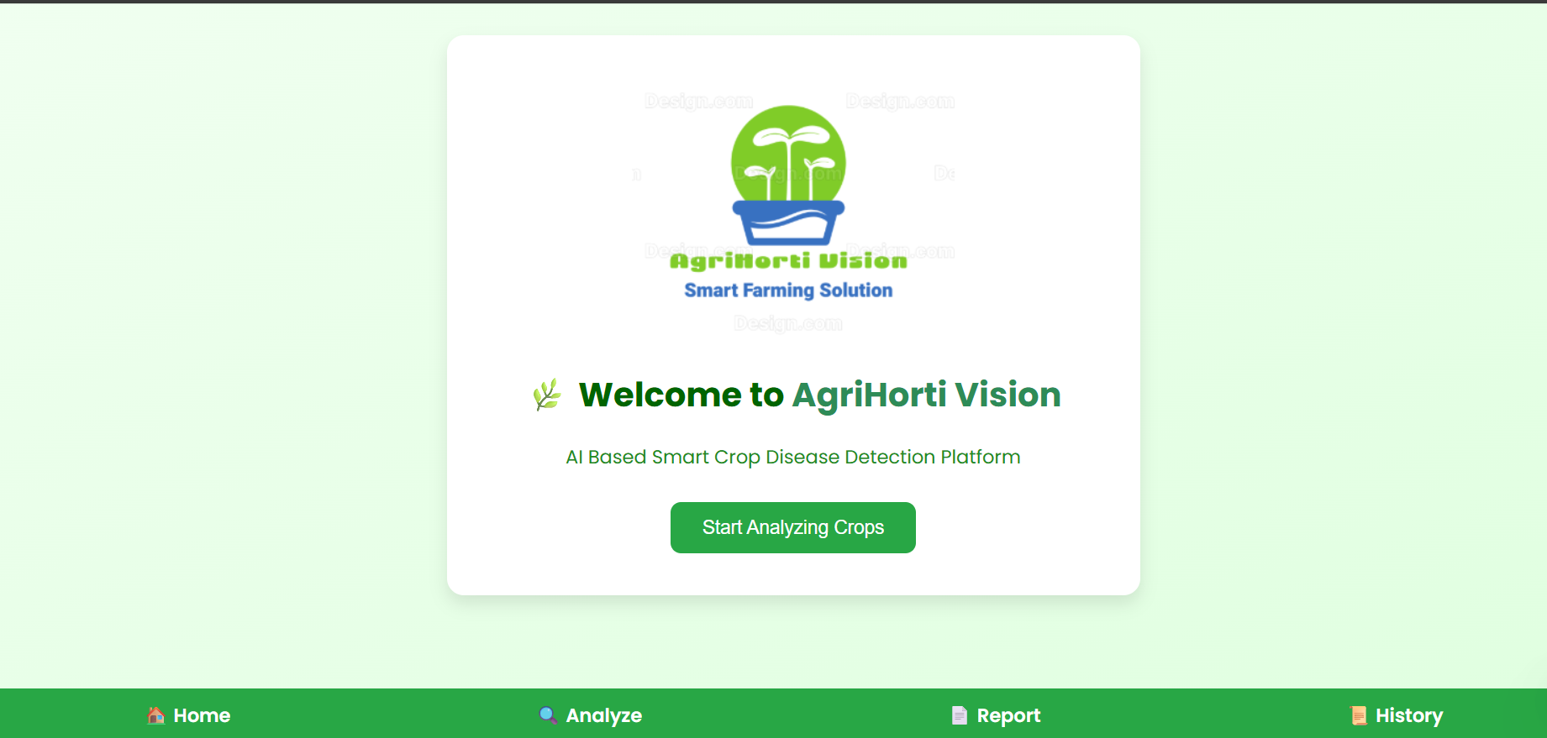
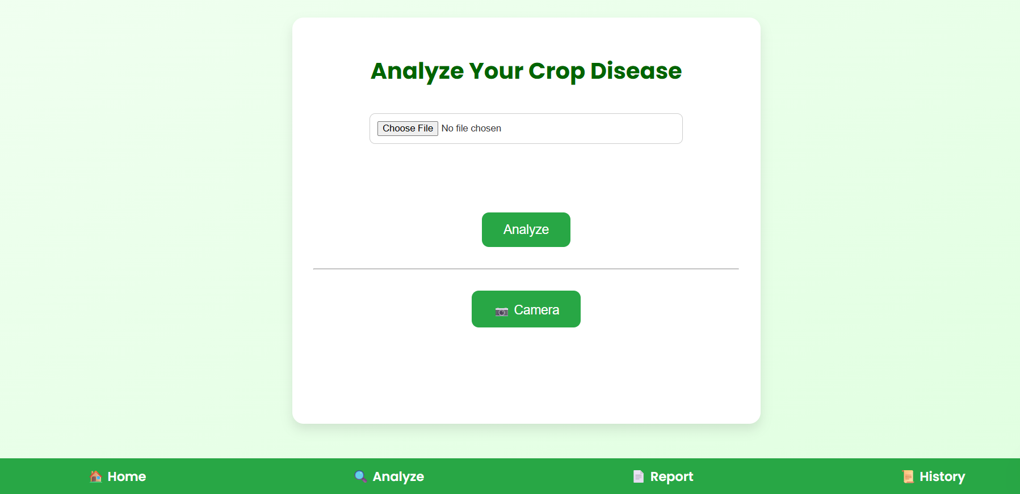
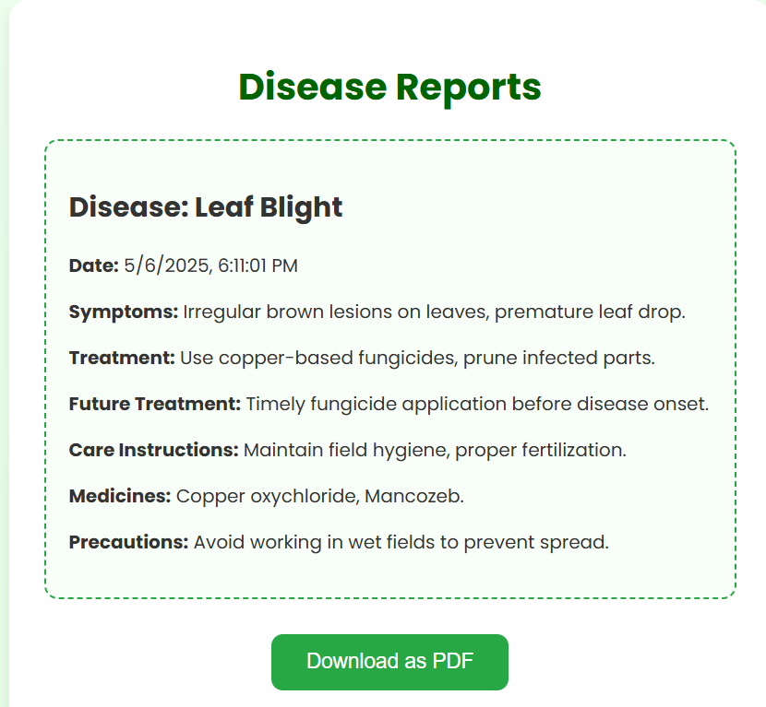
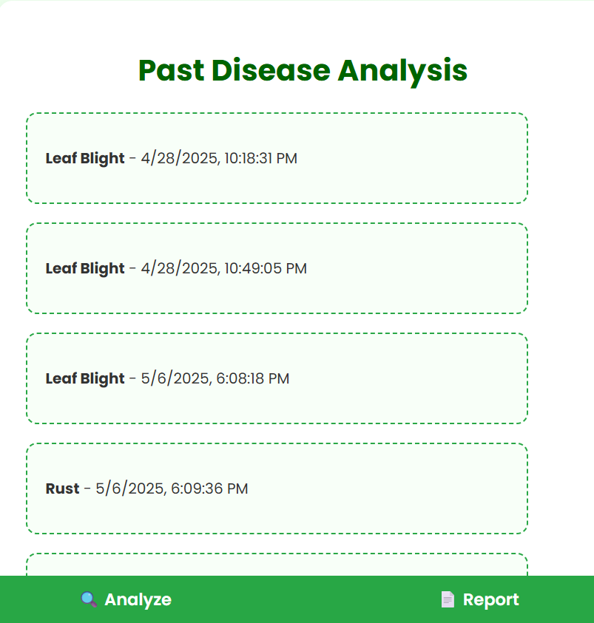
Snippets
Reports Page
History Page
Home Page
Analyze Page

